Slide 1
Entity Relationship
(DBMS)
Notes:
1

Slide 2
Steps to develop DBMS
Requirement
Conceptual Database design
Tables and keys
Logical database design
Constraints
Schema refinement
Normalization
Physical database design
Indixing
Security and Applications design

Slide 21
What is an Entity Relationship Diagram (ERD)?
ERD is a data modeling technique used in software engineering to produce a conceptual data model of an information system.
So, ERDs illustrate the logical structure of databases.

Slide 22
The Importance of Data Model
Blue print: official documentation
Blue print of house
Employee’s w/o DB knowledge can understand
a data model diagram vs. a list of tables
Used as an effective Communication Tool
Improve interaction among the managers, the designers, and the end users
Independence from a particular DBMS
Network DB, Object-oriented DB, etc.

Slide 23
Data Model (con’t)
The data modeling revolves around discovering and analyzing organizational and users data requirements.
Requirements based on policies, meetings, procedures, system specifications, etc.
Identify what data is important
Identify what data should be maintained

Slide 24
ERD
The major activity of this phase is identifying entities, attributes, and their relationships to construct model using the Entity Relationship Diagram.
Entity → table
Attribute →column
Relationship → line

Slide 25
How to find entities?
Entity:
"...anything (people, places, objects, events, etc.) about which we store information (e.g. supplier, machine tool, employee, utility pole, airline seat, etc.).”
Tangible: customer, product
Intangible: order, accounting receivable
Look for singular nouns (beginner)
BUT a proper noun is not a good candidate….

Slide 26
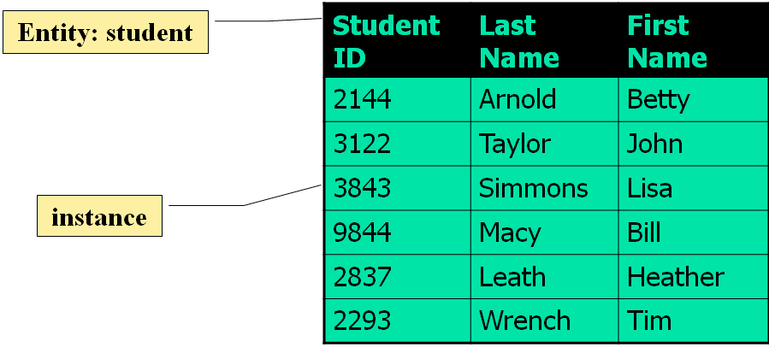
Entity Instance
Entity instance: a single occurrence of an entity.
6 instances

Slide 27
How to find attributes?
Attribute:
Attributes are data objects that either identify or describe entities (property of an entity).
In other words, it is a descriptor whose values are associated with individual entities of a specific entity type
The process for identifying attributes is similar except now you want to look for and extract those names that appear to be descriptive noun phrases.

Slide 28
How to find relationships?
Relationship:
Relationships are associations between entities.
Typically, a relationship is indicated by a verb connecting two or more entities.
Employees are assigned to projects
Relationships should be classified in terms of cardinality.
One-to-one, one-to-many, etc.

Slide 29
How to find cardinalities?
Cardinality:
The cardinality is the number of occurrences in one entity which are associated to the number of occurrences in another.
There are three basic cardinalities (degrees of relationship).
one-to-one (1:1), one-to-many (1:M), and many-to-many (M:N)

Slide 30
Identifier
“attributes that uniquely identify entity instances”
Becomes a PK in RDS
Composite identifiers are identifiers that consist of two or more attributes
Identifiers are represented by underlying the name of the attribute(s)
Employee (Employee_ID), student (Student_ID)

Slide 31
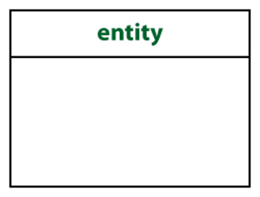
Crow’s Foot Notation
Known as IE notation (most popular)
Entity:
Represented by a rectangle, with its name on the top. The name is singular (entity) rather than plural (entities).

Slide 32
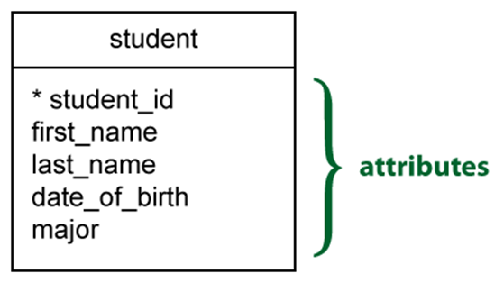
Attributes
Identifiers are represented by underlying the name of the attribute(s)

Slide 33
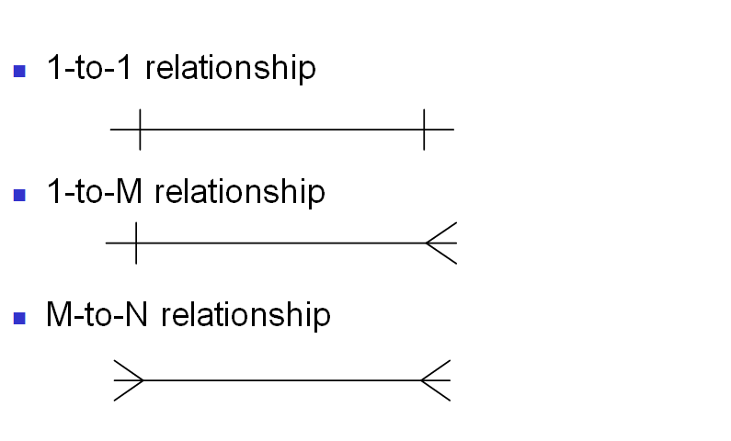
Basic Cardinality type

Slide 34
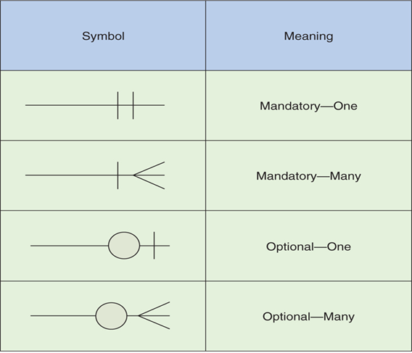
Cardinality con’t

Slide 35
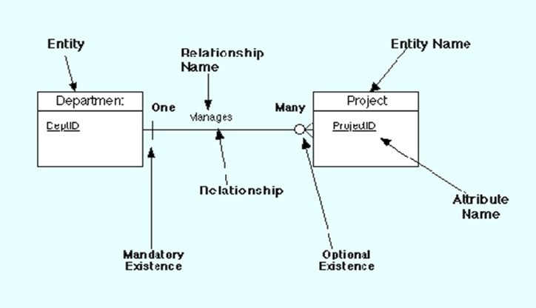
Example Model

Slide 36
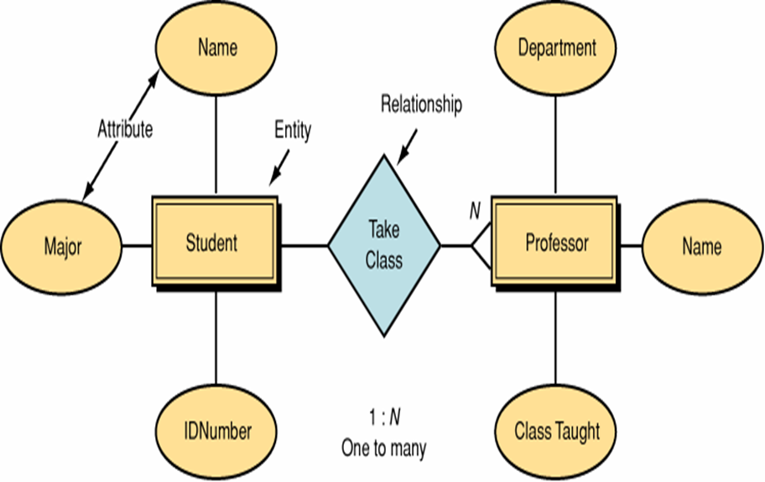
Data Model by Peter Chen’ Notation (first - original)

Slide 37
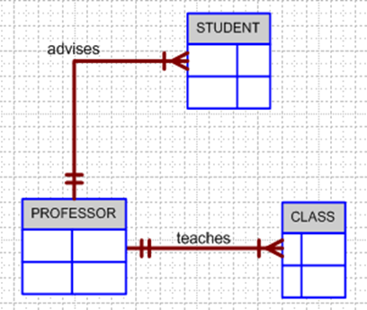
Business Rule Example 1
A professor advises many students (professor to student). Each student is advised by one professor (student to professor).
A professor must teach many classes. Each class must be taught by one professor.

Slide 38
Business Rule 1
Business Rules are used to define entities, attributes, relationships and constraints.
Usually though they are used for the organization that stores or uses data to be an explanation of a policy, procedure, or principle.
The data can be considered significant only after business rules are defined.
W/o them it cannot be considered as data for RDS but just records.

Slide 39
Business Rule 2
When creating business rules, keep them simple, easy to understand, and keep them broad.
so that everyone can have a similar understanding and interpretation.
Sources of business rules:
Direct interviews with internal & external stakeholders
Site visitations (collect data) and observation of the work process or procedure
Review and study of documents (Policies, Procedures, Forms, Operation manuals, etc..)

Slide 40
Attributes
Describe detail information about an entity ”
Entity: Employee
Attributes:
Employee-Name
Address (composite)
Phone Extension
Date-Of-Hire
Job-Skill-Code
Salary

Slide 41
Classes of attributes
Simple attribute
Composite attribute
Derived attributes
Single-valued attribute
Multi-valued attribute

Slide 42
Simple/Composite attribute
A simple attribute cannot be subdivided.
Examples: Age, Gender, and Marital status
A composite attribute can be further subdivided to yield additional attributes.
Examples:
ADDRESS --à Street, City, State, Zip
PHONE NUMBER --à Area code, Exchange number

Slide 43
Derived attribute
is not physically stored within the database
instead, it is derived by using an algorithm.
Example 1: AGE can be derived from the date of birth and the current date.
MS Access: int(Date() – Emp_Dob)/365)

Slide 44
Single-valued attribute
can have only a single (atomic) value.
Examples:
A person can have only one social security number.
A manufactured part can have only one serial number.
A single-valued attribute is not necessarily a simple attribute.
Part No: CA-08-02-189935
Location: CA, Factory#:08, shift#: 02, part#: 189935

Slide 45
Multi-valued attributes
can have many values.
Examples:
A person may have several college degrees.
A household may have several phones with different numbers
A car color

Slide 46
Example - “Movie Database”
Entity:
Movie Star
Attributes:
SS#: “123-45-6789” (single-valued)
Cell Phone: “(661)123-4567, (661)234-5678” (multi-valued)
Name: “Harrison Ford” (composite)
Address: “123 Main Str., LA, CA” (composite)
Gender: “Female” (simple)
Age: 24 (derived)

Slide 47
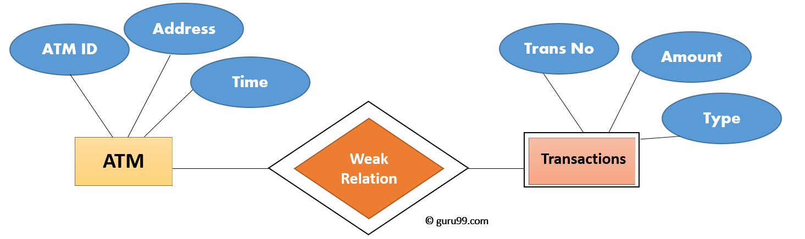
Weak Entities
A weak entity is a type of entity which doesn't have its key attribute.
It can be identified uniquely by considering the primary key of another entity.
For that, weak entity sets need to have participation.
In above ER Diagram examples, "Trans No" is a discriminator within a group of transactions in an ATM.

Slide 48
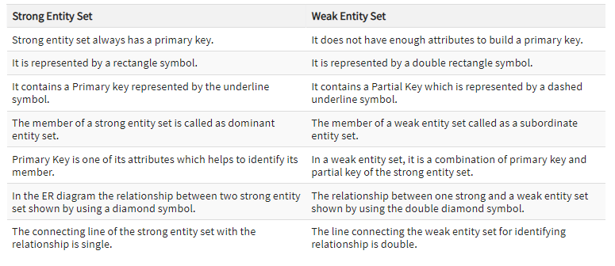
Difference b/w Strong and Weak Entity Set

Slide 49
Problem-1
Consider the table below where employee may or may not have supervisor
E_no is P.K.
Supervisor_Id is
F.K referencing to PK
If you want to insert a tuple "E6 D E7", will the DBMS allow you to insert the tuple?
E_No (PK) | E_Name | Supervisor_ID (FK)
E1 | A | E2
E2 | A | Null
E3 | B | E2
E4 | C | E3
E5 | C | E4

Slide 50
Problem-2
Consider the table below where employee may or may not have supervisor
E_no is P.K.
Supervisor_Id is
a F.K referencing to PK
Integrity Constraint:
on delete no action
If you want to delete a tuple "E2 A Null“, will the DBMS allow you to insert the tuple?
E_No (PK) | E_Name | Supervisor_ID (FK)
E1 | A | E2
E2 | A | Null
E3 | B | E2
E4 | C | E3
E5 | C | E4

Slide 51
Problem-3
Consider the table below where employee may or may not have supervisor
E_no is P.K.
Supervisor_Id is
a F.K referencing to PK
Integrity Constraint:
on delete cascade
If you want to delete a tuple "E2 A Null", will the DBMS allow you to insert the tuple? If yes, how many tuples will remain in the table after performing the deletion query.
E_No (PK) | E_Name | Supervisor_ID (FK)
E1 | A | E2
E2 | A | Null
E3 | B | E2
E4 | C | E3
E5 | C | E4

Slide 52
Problem-4
A | B | C
2 | 3 | 4
3 | 5 | 4
4 | 9 | 3
5 | 7 | 2
9 | 8 | 5
6 | 8 | 4
In the above table, which attributes qualify to be primary key and foreign key?

Slide 53
Problem-5
A | B | C
2 | 3 | 4
3 | 5 | 4
4 | 9 | 3
5 | 7 | 2
9 | 8 | 5
6 | 8 | 4
A is Primary key and C is foreign key referencing to attribute A.
Integrity Constraint: on delete cascade
If you delete tuple (2,3,4), how many tuples will remain in the table

